Slide 1
SVM Classification technique
Understand in details the SVM classification technique. Apply it on the loan dataset using three different types of kernel and compare the performances.

Slide 2
SVM
SVM works by finding the support vectors, which are the data points closest to the hyperplane. The support vectors are used to determine the position and orientation of the hyperplane. SVM also uses a kernel function to map the data into a higher-dimensional space, where it can be separated by a hyperplane.

Slide 3
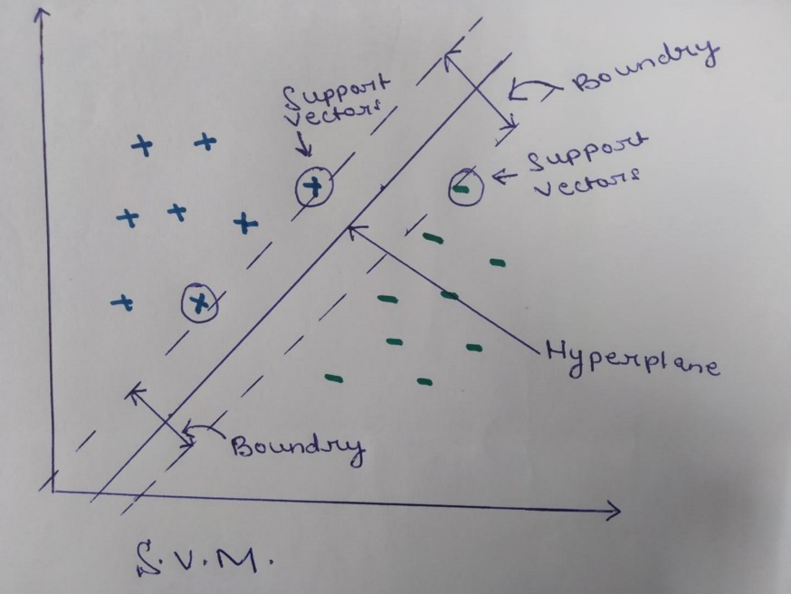

Slide 4
kernel
Linear Kernel : Used for linear data classification
Polynomial Kernel :Used for Non-linear data classification
Radial or RBF kernel :Used for Non-linear data classification

Slide 5
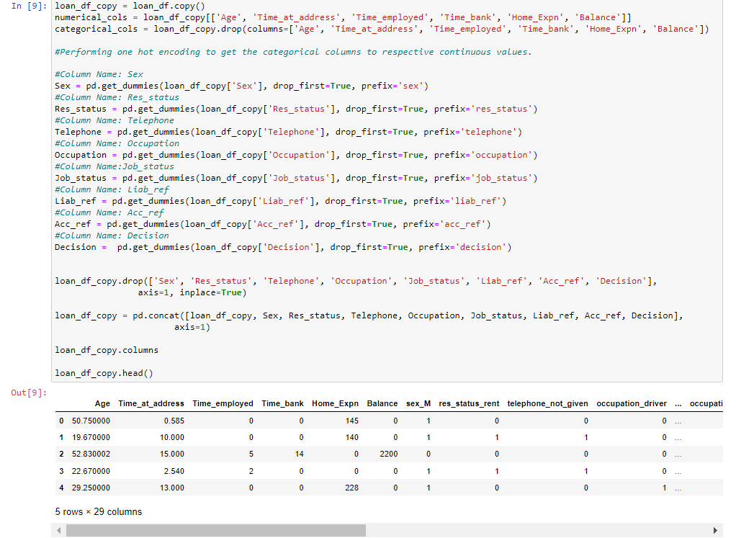
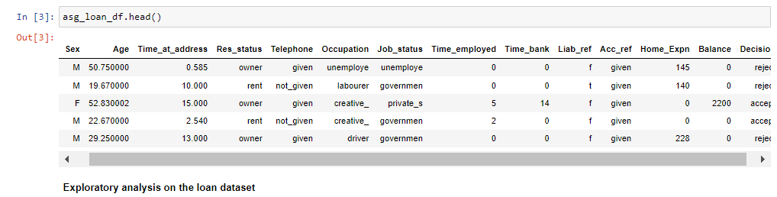

Slide 6
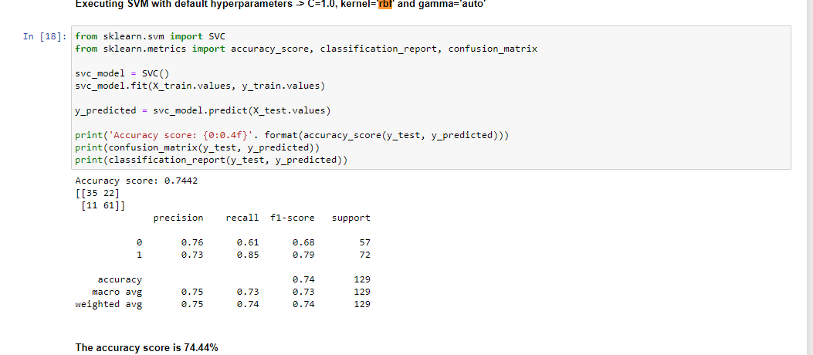
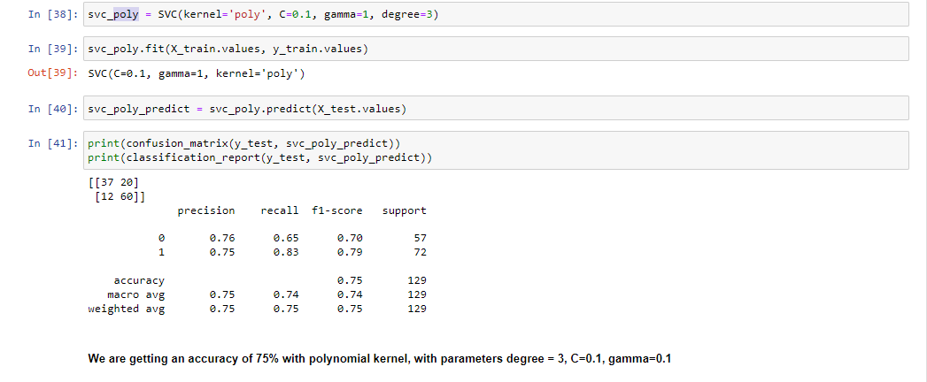

Slide 7
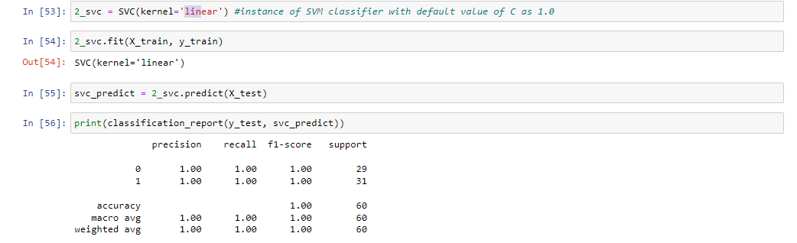

Slide 8
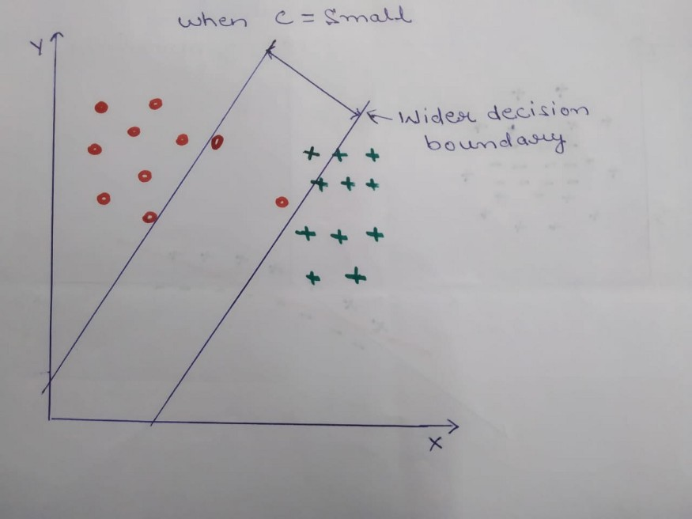
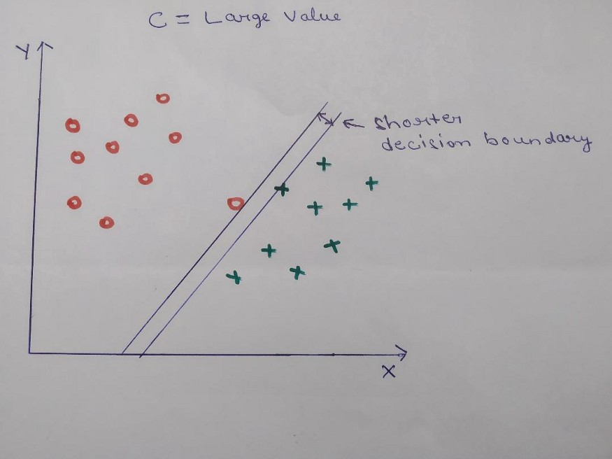

Slide 9
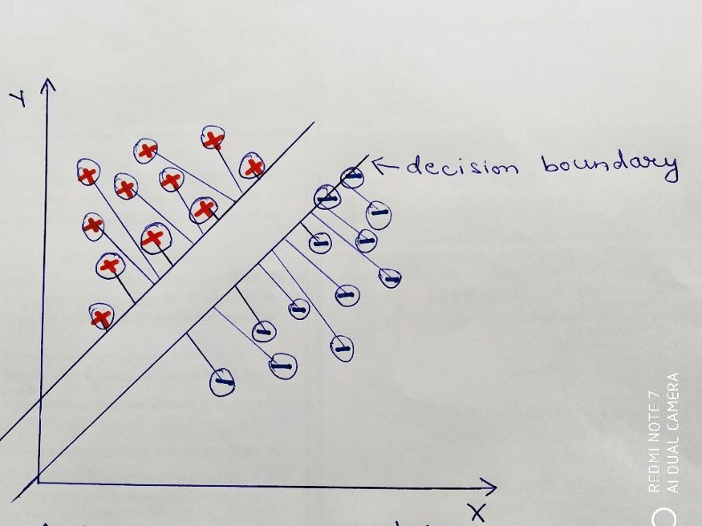
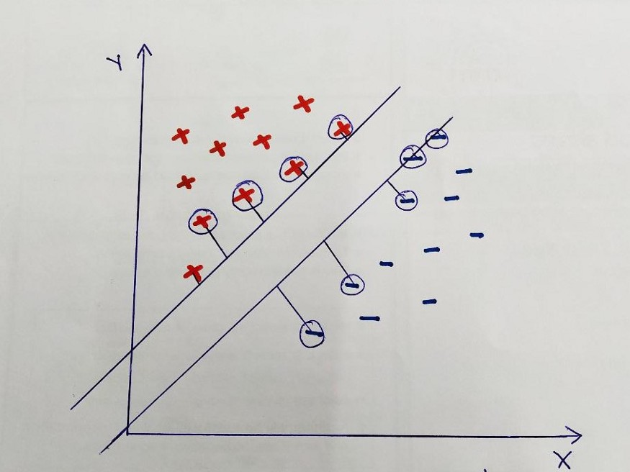
High Gama value/Low Gamma value

Slide 10
